Slide 1
CCLLs sensors management Community-based environmental monitoring
SCORE Webinar # 6
José P. Gómez Barrón | UCD
01 March 2024

Slide 2
Outline
Sensor Onboarding
Sensor Data Visualization
Community Geosurveys
Notes:
Diversity of makes very complex the management of all in a same platform

Slide 3
Sensors Onboarding
Processes and tools involved:
Sensor registration on its proprietary IT platform (specific for each sensor).
Sensor registration on the SCORE STA API platform. (manually, onboarding web app)
Data collectors (harvesters) setup (for some sensor cases) and data bulk uploader web app
OGC SensorThings API: standard to manage and retrieve observations and metadata from heterogeneous IoT sensor systems.

Slide 4
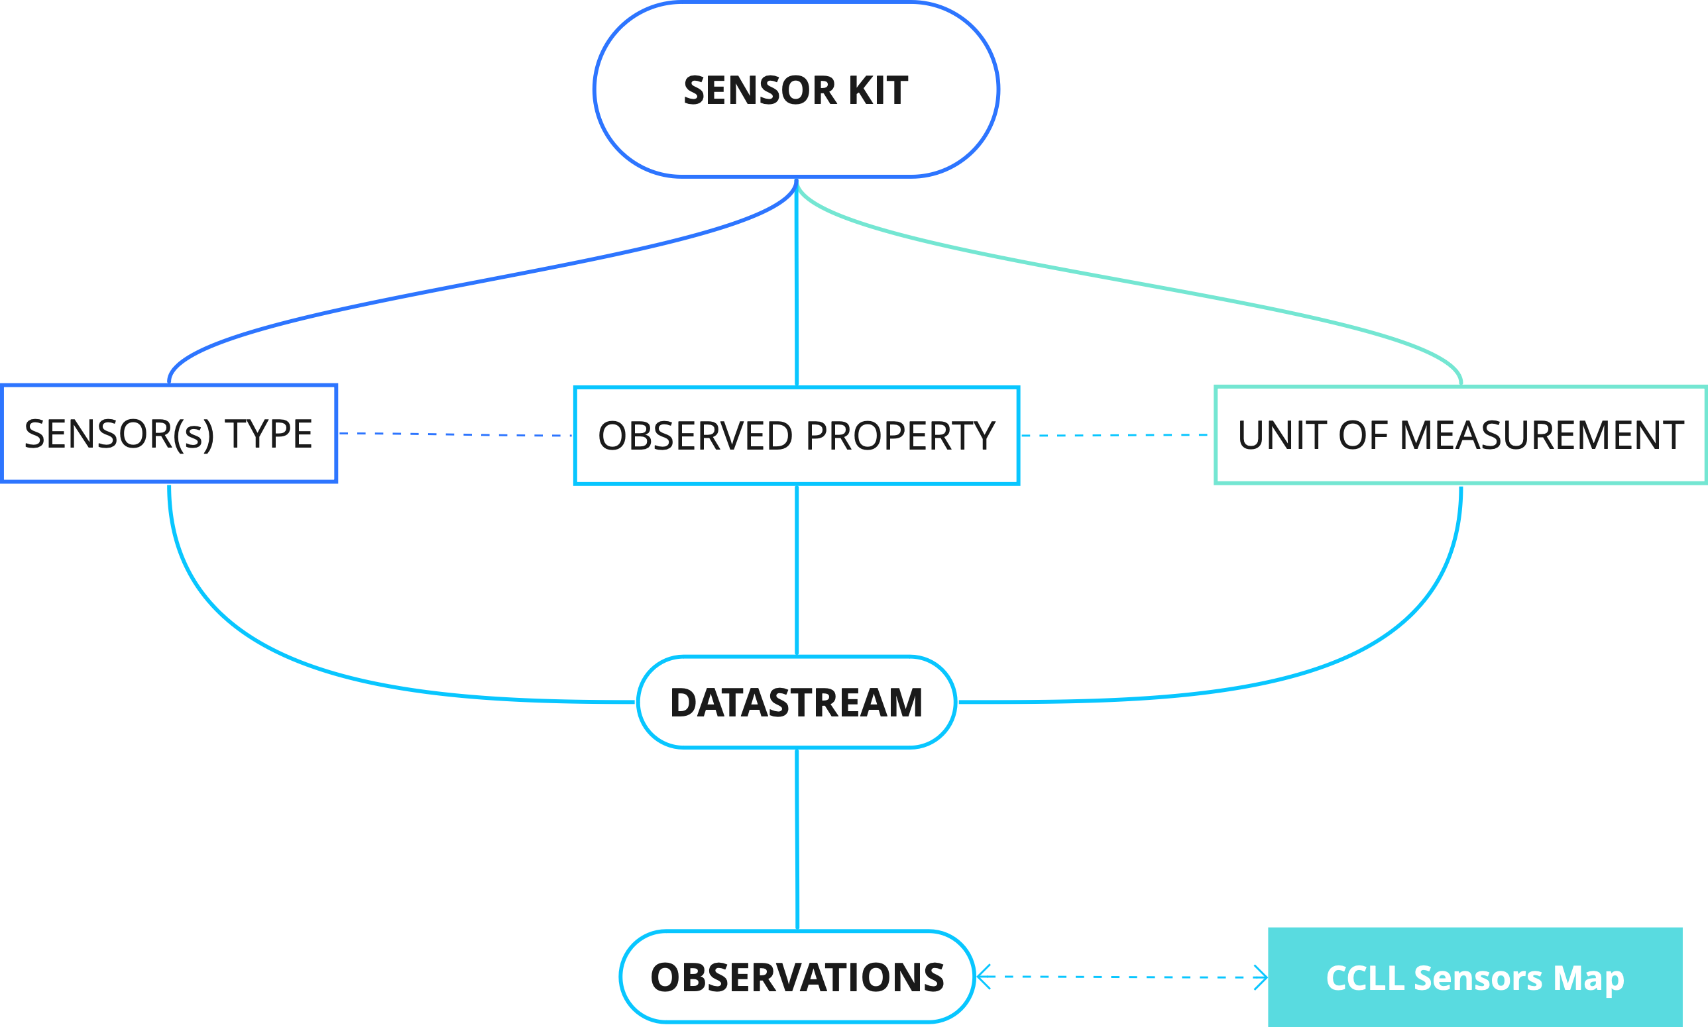
Sensors Onboarding

Slide 5
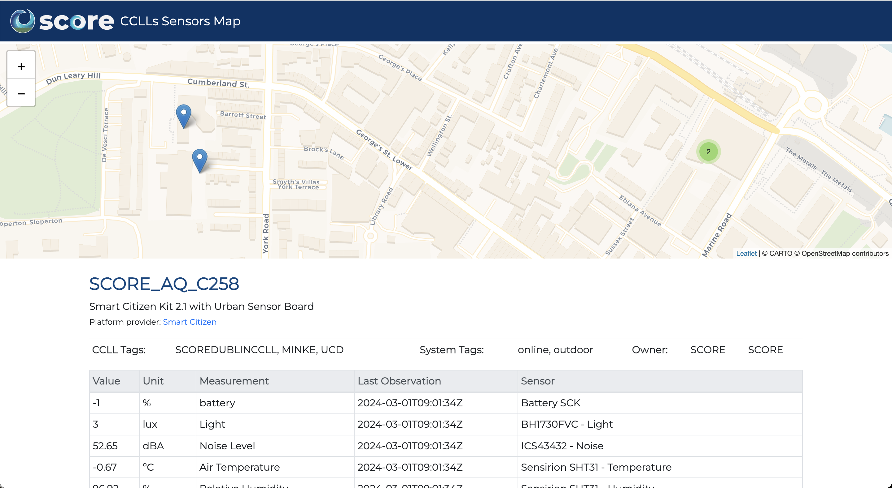
Sensor Data Visualization
Data access:
SCORE STA endpoints + on the sensor proprietary IT (for some cases)
CCLLs Sensors Map

Slide 6
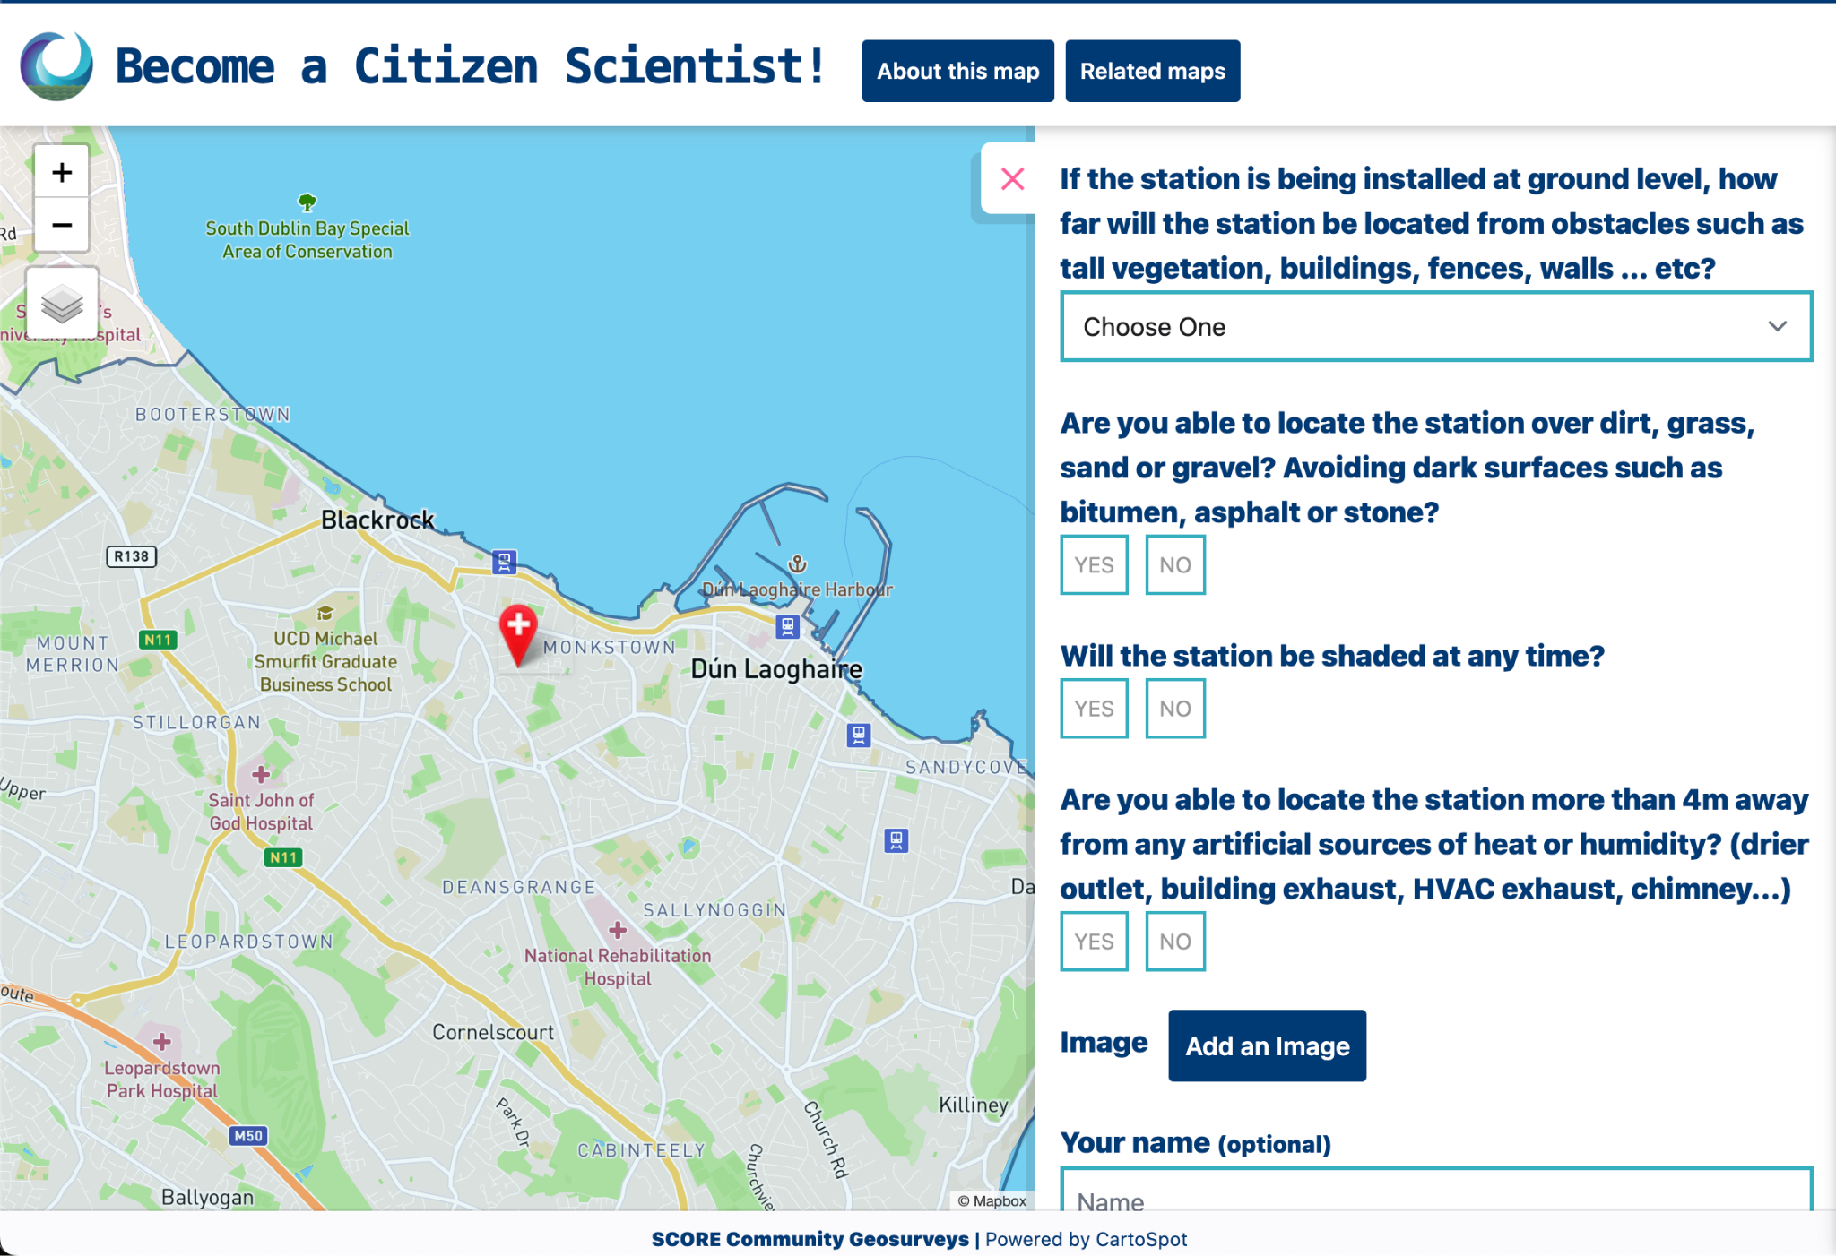
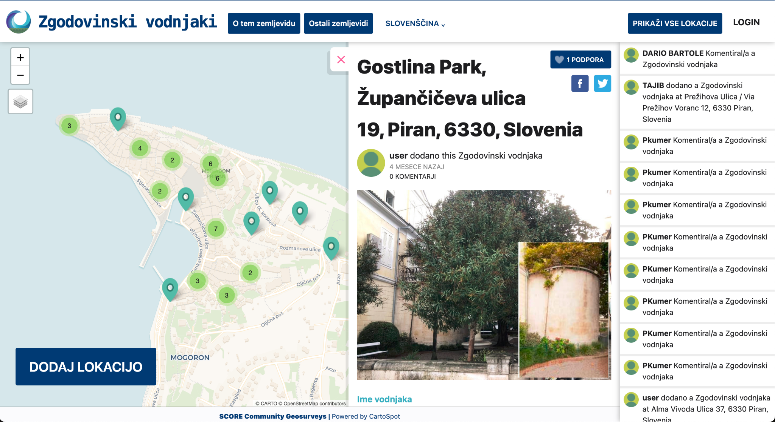
Community Geosurveys
First version release
Notes:
Version 2 will be finished and release to the CCLLs iin February:
- CCLLs users accounts for designing and setting up their own map with its survey without WP4 team manual setting.
- For the later we are working together with WP5 to find a common user management among citizen applications first.
- New functionality for user comments in an existing point to also a photograph can be included. (Mandatory requirement for the CCLLs coastsnap approach).

Slide 7
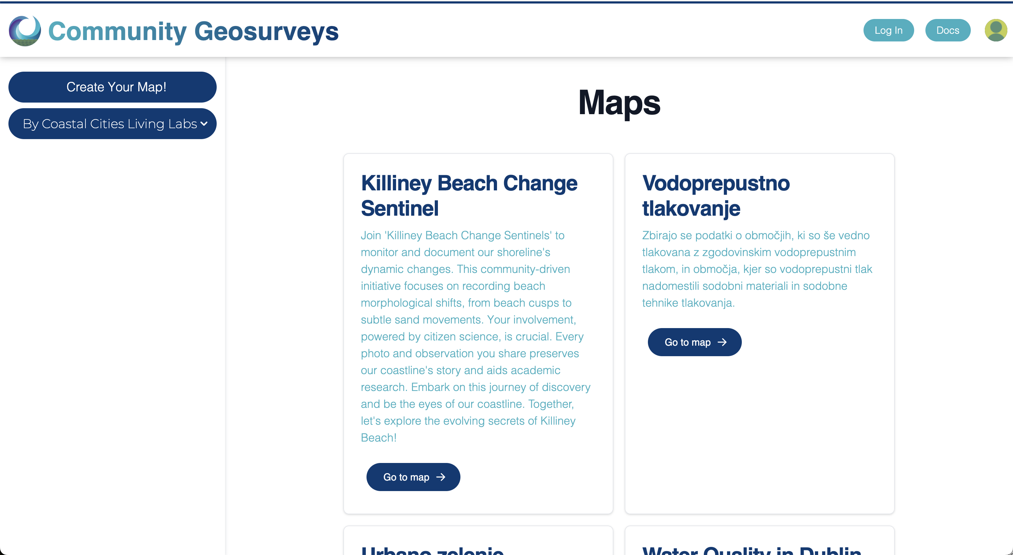
Community Geosurveys
Demo: How to create your map.
Notes:
Version 2 will be finished and release to the CCLLs iin February:
- CCLLs users accounts for designing and setting up their own map with its survey without WP4 team manual setting.
- For the later we are working together with WP5 to find a common user management among citizen applications first.
- New functionality for user comments in an existing point to also a photograph can be included. (Mandatory requirement for the CCLLs coastsnap approach).

Slide 8
Thank you!
www. score-eu-project . eu
jose.gomezbarron@ucd.ie

