Slide 1
Model City Coastal City Living Lab
Pilot Operational Plan (POP)
A template for use by Living Labs

Slide 2
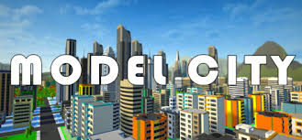
INTRODUCTION
Using this document
Model City Pilot Operational Plan
This document presents Model City's Pilot Operational Plan (POP) to define and develop a Coastal City Living Lab, which is a type of Living Lab that aims to build climate resilience in coastal communities. First, the POP for Model City is presented, detailing the different activities taking place within the phases of the POP. Then the links of the POP with the SCORE activities are summarised as well as the general calendar for Model City’s CCLL. Next, both the contextualisation and assessment of Model City are described in detail. Utilise this example as a template for your own Living Lab and adapt it to your own context.
Annex: Proposed Tools and Templates​
The annex of this document provides examples and further details of proposed activities, as organised by the recommended phase within the LL process. However, it is important to note that many of these tools can be utilised at more than one point to achieve different objectives. For more information on how to select when to use these different tools, see the POP Guidelines and Instructions here. Additional tool guidance and templates can be found in the Co-Creation Toolkit, which you can access here.
2

Slide 3
MODEL CITY COASTAL CITY LIVING LAB
PILOT OPERATIONAL PLAN
3

Slide 4
PILOT OPERATIONAL PLAN: MODEL CITY
This document follows the structure of the POP and further describes the first phase for the CCLL of Model City.
PHASE 1: EMPATHISE & DEFINE
Diagnosis of the situation of the city. The principal objective of this initial phase is to analyse the context of the city and based on it define the structure of the CCLL.
PHASE 2: IDEATE & CO-DESIGN
Definition and design of the solution or solutions to the problems selected in the first phase. The main aim of this second phase is to co-create and co-design the most appropriate solutions to the selected problems.
PHASE 3: PROTOTYPE & PILOT
Implementation of the ideated and co-created solutions. The principal objective of this phase is to pilot the solutions that have been agreed to test their applicability and utility in the field.
PHASE 4: TEST & EVALUATE
Evaluate the designed and prototyped solutions in a bigger scale. The main objective of this phase is to, based on the results of Phase 3, test the developed solutions in a larger feedback group to ensure its utility.
4

Slide 5
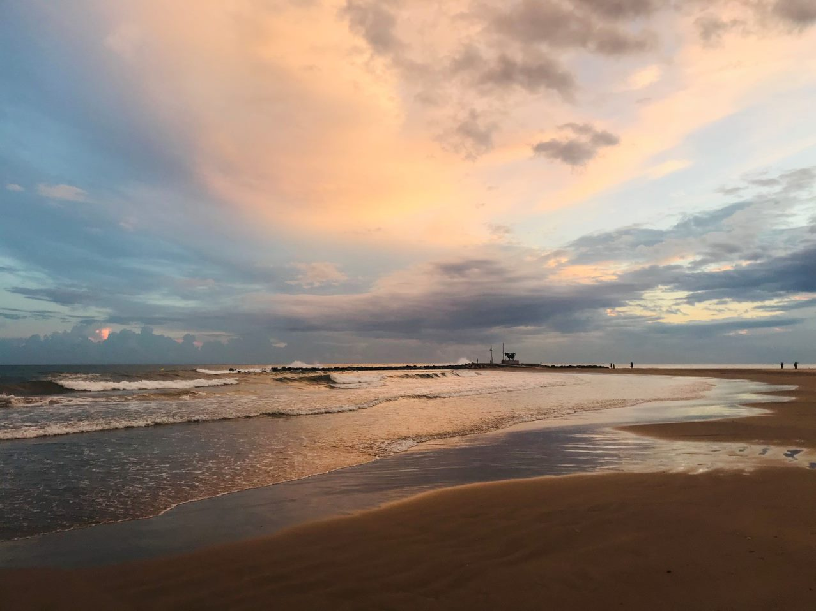
PHASE 1: EMPATHISE & DEFINE
Diagnosis of the situation of the city. The principal objective of this initial phase is to analyse the context of the city and based on it define the structure of the CCLL.
Model city is located in the northeast of Climaterdam, and it has up to 67,087 habitants.
Overall, the city is located at 22 meters above sea level, with the highest part of the city at 300 m above sea level in the northern area. The municipality of Model City has more than 12,000 trees and 134,000 m² of green areas. Moreover, "Florida Park" is a natural area included in the Nature 2000 Network and considered a Site of Community importance (SCI) and a Special Protection Area. Also, Sunrise beach is a coastal area of about 10ha located a 3 km south of Model City. It is bounded on the north by the railway line, on the south by the sea and on the west by the municipality of Cube City, very close to the wetland of the mouth of the Fox River. It is part of an old area of wetlands and coastal dunes of the Fox River delta and is one of the last remaining natural areas of the old river delta. Finally, the "Coast of Turtles" marine area - which covers the coastal area between the municipalities of Castelvillage and Cuno - is included in the Nature 2000 Network and is considered a SCI and SPA. It is notable for the presence of Posidonia oceanica and Cymodocea nodosa grasslands, which provide refugee for various species of fish and invertebrates.
THERE ARE SEVERAL ISSUES IDENTIFIED BY THE CITY THAT ARE CONSIDERED A CONSEQUENCE OF CLIMATE CHANGE:
The main natural or climatic-related hazards that affects the area of the CCLL are coastal floods, land floods, landslide, heatwave, drought, coastal storm surge and coastal erosion. These hazards have a direct impact on tourism, cultural heritage sites, energy networks, transport networks and both commercial and residential buildings.
5

Slide 6
PHASE 1: EMPATHISE & DEFINE
Scoping
Scoping is the first activity of the POP. Scoping can be defined as the comprehensive activity where the characteristics and context of the city are identified, this also includes resources and barriers as well as the selection of the climatic problems that need to be faced. Based on the first analysis of context and climatic problems, more operational activities are also included, such us; the definition of the structural organisation of the CCLL, which should include a common vision and goals of all the identified stakeholders. The main actions related to this activity are described as follows:
Identify the key challenges being faced and define the roots of the identified problems, not just the symptoms.
Study the available data on the ecosystem surrounding of the LL, scope and understand the context.
Define the main goals of the LL considering the inputs from all stakeholders.
Identify the available resources for a proper implementation of the LL.
Select between 1 and 3 practices to be addressed by the LL in the upcoming years.
Identify the practices related to the relevant actors, those with large impact (positive or negative) on the ecosystem.
Decide the operational structure of the LL. Who will be part of the team, what are their roles and responsibilities?
Examples of SCORE CCLL activities
What: Collect different types of past events climate maps to understand the context
By: CCLL core team
What: Workshop to define the vision of the CCLL.
By: CCLL core team & relevant stakeholders
What: Gather the communities’ climate change perception
By: stakeholders
What: Gather users' stories and specifications
By: stakeholders
6

Slide 7
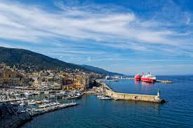
PHASE 1: EMPATHISE & DEFINE
Scoping
Model City CCLL's main goal is to achieve institutional recognition of the CCLL by setting up a strong and stable structure of committed stakeholders, co-creating data based innovative solutions for climate change adaptation.
TO DO SO…
Model City’s CCLL has strong public institutions with high commitment and support in the topics of the project.
…Model City’s CCLL has stakeholders who share the same vision but complement their point of view.
…Model City’s CCLL has budget and resources available
…Model City’s CCLL has previous experience with LL
…Model City’s CCLL has knowledge and experience in adaptation to climate change
HOWEVER, Model city’s CCLL encounters a series of barriers that might hamper the CCLL’s activity:
Difficulties to sustain stakeholder’s engagement.
Limited multidisciplinary of the team-they all have strong focus on the environment
Difficulties to engage investors in LL methodology
Difficulties in engaging citizens in LL codesign methodology
5. People in the project might change to other companies and the references change making the process to achieve the results more difficult.
7

Slide 8
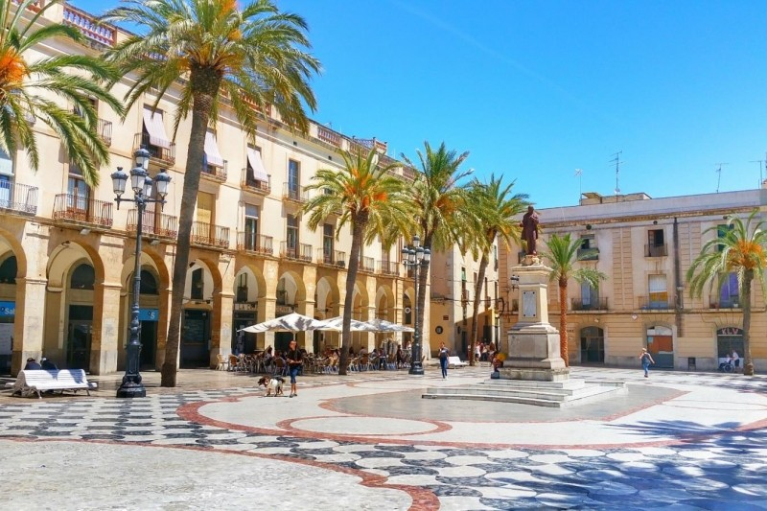
PHASE 1: EMPATHISE & DEFINE
Scoping
Model City CCLL’s main barrier is considered to be:
Difficulty to sustain stakeholders’ engagement in the whole Living Lab process
The roots of this barrier have been highlighted as:
Unclear results/benefits for stakeholders
Weak participation culture
Some people have resistance to change
Difficulty in managing participatory processes.
Unsuccessful past experiences
Difficulties to measure past experiences
Lack of incentives to participate & engage in the LL process
Unclarity on what incentives look for stakeholders
Difficulties in marketing a good environment in meetings
Lack of recognition of previously engaged stakeholders
Differences in commitment levels
Different drivers
Different perspectives on the proposed solutions
Lack of recognition
Limited knowledge and experience in the LL process
Lack of understanding of the terminology of LL
Difficulties to find a good time to meet during the process.
Very little time between participation and implementation
Complexity of data management
Limited availability of climate related data at local level
Diversity of information needs per stakeholder
Lack of understanding of climate change related terms
Unclear roles of the CCLL core team
Unclear levels of commitment
Lack of experience on setting up a CCLL
No clear governance
8

Slide 9
PHASE 1: EMPATHISE & DEFINE
Scoping
As a result of the stakeholder mapping exercise, the prioritised key stakeholders for the CCLL activity are summarised following the Quadruple Helix Model.
Coastal Government
Climate Department of the Government
Climate Change Model City office
Government
University of Model City
Model City Observatory
Technical School of Model City
1
Academia
4
2
Industry
3
Fishermen
Tourism Board of Model City
Chamber of Commerce Model City
Technological Co-work of Model City
Neighbourhood Association of Model City north
Ecologist group of Model City
Farmers of Model City
Climate organisations
Surf organisations
​
People
9

Slide 10
PHASE 1: EMPATHISE & DEFINE
Planning
Once the current reality of the city is understood, the process of Phase 1 is followed by Planning. This second action refers to the identification of the relevant stakeholders that should be part of the CCLL to be sure all points of view of the city concerning not only the climatic context but also the approaches are considered. Indeed, during this activity, the most relevant agents that the CCLL team intends to incorporate must be identified, informed, and linked with the following planned actions for the development of the CCLL. In order for this action to be successful, clear and solid communication channels with all actors should be also established.
The main actions related to this activity are described as follows:
Define a common vision and shared goals among the relevant stakeholders.
Establish the structural organisation of the CCLL; Who will need which support?
Evaluate the need of different plans depending on the select problem and the involved stakeholders.
Process of stakeholder mapping with actions planned for the support of establishing communication channels with all stakeholders.
Define the main indicators to measure the impact of the chosen actions.
Examples of SCORE CCLL activities
What: Workshop to define the structure of the CCLL.
By: CCLL core team
What: Provide contact person with technical background for climate projections
By: CCLL core team
What: Provide data on exposure/vulnerability of: infrastructure, population, buildings.
By: CCLL core team
What: Provide data on financial risk management and quantification of losses.
By: CCLL core team
10

Slide 11
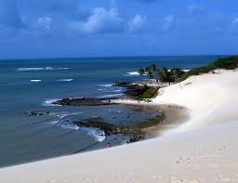
PHASE 1: EMPATHISE & DEFINE
Planning
VISION OF THE CCLL IS TO:
BECOME A REFRENCE AND RESEARCH-TECHNOLOGICAL ENGINE, CO-CREATING DATA BASED, INNOVATIVE AND COLLABORATIVE SOLUTIONS TOWARDS INTEGRATED COASTAL MANAGEMENT AND CLIMATE CHANGE ADAPTATION, SCALED UP TO CLIMATERDAM AND THE SUNRISE AREA
THE CCLL HAS THREE STRATEGIC GOALS:
Enhance research, technical and financial capacity of the CCLL to propose, promote, validate and monitor EBA solutions.
Develop a clear communication strategy by engaging all stakeholders to share and showcase climate-related data and promote integrated coastal management solutions.
Build the CCLL capacity to be able to scale up and replicate the LL methodology in Climaterdam and in the Sunrise sea area.
11

Slide 12
PHASE 1: EMPATHISE & DEFINE
Planning
VISION OF THE CCLL IS TO:
BECOME A REFERENCE IN ECOSYSTEM-BASED SOLUTIONS AND COASTAL ADAPTATION IN CLIMATERDAM, THROUGH ENHANCED ENGAGEMENT OF KEY STAKEHOLDERS AND CITIZENS PARTICIPATION.
CCLL STRUCTURE
CCLL Manager
Main person responsible for the Living Lab, managing everyday practices of the Living Lab while guaranteeing the sustainability of the Living Lab by developing Living Lab projects to keep the long-term strategy aligned.
John Doe, Model City Council
Supported by Noripolis
Panel Manager
People-oriented profile, playing a central role between internal and external stakeholders and coordinating communication, engagement, and interaction with users & stakeholders
Jane Doe, Model City council for local tasks
Laura Doe, Climaterdam Provincial Council for supra-municipal tasks
Project Manager
Responsible for the management of a particular Living Lab project, planning, procuring, and executing the Living Lab project.
Michael Doe, Noripolis
Human Interaction Specialist
research-oriented profile of the team, selecting, preparing, performing, and analysing co-creation methods and tools.
James Doe, FOXI
Supported by Model city council
Pilot Manager
technical profile, in charge of setting up, running and scaling-up the technologies used in Living Lab projects.
Sarah Doe, Model City Council
Supported by Noripolis and Climaterdam Provincial Council
​
IN ORDER TO HAVE EFFECTIVE AND EFFICIENT COMMUNICATIONS, THE CORE TEAM, DEVELOPED A PLAN WHERE THREE PHASES WERE DEFINED FOR ALL STAKEHOLDERS:​
1 – PHONE​
2 – E-MAIL​
3 – MEETING
FOR DATA COLLECTION​ AND USER PARTICIPATION:
1- SURVEYS (WHATSAPP)
1
4
2
3
12

Slide 13
PHASE 1: EMPATHISE & DEFINE
Supporting/Protecting/Rewarding
Once the main structure of the CCLL is defined, the process of Phase 1 ends with a group of three actions: Supporting, Protecting and Rewarding, all related to stakeholder management. These actions are presented together as the end of Phase 1 as the activities to be implemented in each are related and can be conducted indistinctly over time. In other words, Supporting, Protecting and Rewarding are the final part of Phase 1 where the administrative issues arise, and the CCLL operational strategy is determined. In detail, these actions include the required legal and protection activities as well as the communication and participation protocols. The main actions related to this activity are described as follows:
Implement all the legal and protection actions. Specially related to data protection (GDPR)
Check necessary insurances to the activities that are foreseen.
Establish a “helpdesk” for the panel of stakeholders to use for support.
Act under the common vision and shared goals that enable to mash up and co-design with the users. Celebrate victories
Define a continuous process of support during the definition of measures, as well as the co-design process. The support process will expand through the entire project.
Examples of SCORE CCLL activities
What: Workshop to define the strategy of the CCLL
By: CCLL core team
What: Review the legal requirements that should be considered to build the CCLL
By: CCLL core team
What: Define a helpdesk to facilitate the management of the CCLL
By: CCLL core team
13

Slide 14
PHASE 1: EMPATHISE & DEFINE
Supporting/Protecting/Rewarding
As strategies for rewarding & celebrating the CCLL team highlighted to main ideas:
1
Share the knowledge produced by the CCLL by participating in local fair, international congresses and similar.
2
Conduct recognition (on the website, adding logos…) actions depending on the stakeholder. Mainly share on social media and newsletters the collaborations and activities that are conducted as well as produce material recognition such as certificates, books, plates, university credits...
3
Establish a community of practice to share the knowledge and activities conducted in the CCLL, mainly with citizens through excursions, contests, debates or similar.
LEGAL REQUIREMENTS
The CCLL team has recognised the existence of already established legislation in order to protect users and their privacy.
Internal Validation
Data protection laws
Patents related to sensors and data
Regarding the different work packages, the requirements are listed as follows:
Legal Framework for disaster management – WP6
Data related to damages -WP6
Users agreement & informed consent – WP2
Sensors & data usage – WP4
Insurance on technologies – WP2
Data agreements partners – WP2
Insurance for users – WP2
14

Slide 15
PHASE 2: IDEATE & CO-DESIGN
Launching
Definition and design of the solution or solutions to the problems selected in the first phase. The main aim of this second phase is to co-create and co-design the most appropriate solutions to the selected problems.
Launching is defined as a creative and practical activity where the relevant stakeholders are brought together to ideate and co-design the most suitable solution for the identified climatic problems. This activity covers from the ideation (need finding) over co-creation (solution definition) to co-design (creating a proof concept/mock up). During this process some questions must be raised regarding the obtained feedback, is the CCLL able to receive proper feedback? If not, why not? It also includes the gathering of different approaches proposed by the selected stakeholders. Once the barriers and proposals are understood, the first Living Lab activities related to the CCLL are initiated in relation to the life-cycle approach, involving the identified participants for each activity. The main actions related to this activity are the following:
Ideate what can possibly be needed in order to co-create and co-design possible solutions. Ideally a proof of concept or mock-up should be done.
Conduct a socioeconomic assessment of the ideated solution.
Establish a methodology to evaluate the performance. Measurement, verification, and performance scorecards enable scale up & impact assessment.
Establish channels to facilitate to receive feedback (what is missing). Understand the existence of different approaches by different stakeholders.
Relation with SCORE CCLL activities
What: Workshop to co-create & co-design the EBA solution
By: CCLL core team & end users
What: Develop a financial resilience strategy considering the co-designed EBA solution
By: CCLL core team
What: Conduct a socio-economic assessment of the proposed EBA interventions
By: CCLL core team
15

Slide 16
PHASE 3: PROTOTYPE & PILOT
Monitoring
The third phase is related to the implementation of the ideated and co-created solutions. The principal objective of this phase is to pilot the developed solutions to test their applicability and utility in the field.
Monitoring is an implementation activity where technology is prototyped and tested to monitor the locations for the designed solutions in the previous activities. Hence, this activity can be explained as the process of understanding and evaluating the suitability of the actions and decisions taken by the CCLL, which includes the identification of the strongest and weakest areas or locations. It includes the monitoring process of the established goals by the CCLL as well as the definition of an evaluation process to measure and verify the performance of the chosen actions. The main actions related to this activity are the following:
Prototype the designed solutions to test them in a small-scale.
Understand and evaluate the performance of the CCLL.
Identify the strongest and weakest areas of the testing in order to generate improvements.
Analyse stakeholder participation. Knowing is growing. Staying on top of how different agents are acting and performing. How is the interaction with stakeholders? Who are the ones making a bigger impact? Who are the ones with less impact and interaction? Why?
Monitor the established goals by the CCLL. Which goals were being accomplished & which not? Why?
Examples of SCORE CCLL activities
What: Test of the proposed
solutions with a pilot
By: CCLL core team & relevant stakeholders
What: Introduce existing climate sensors in the citizens’ science platform & pilot test new ones
By: CCLL core team & relevant stakeholders
What: Conduct the first interaction among users and the Digital Twin
By: end users
16

Slide 17
PHASE 4: TEST AND EVALUATE
Learning Lessons
Evaluate the designed and prototyped solutions in a bigger scale. The main objective of this phase is to, based on the results of Phase 3, test the developed solutions in a larger feedback group to ensure its utility.
This activity is defined as the final testing that proves the success of the designed solutions and gathers the main conclusions of the entire process. As the solutions are tested at a bigger scale, the activity enables to identify useful outcomes to be defined so they can be used in future implementation processes or in other CCLLs. This also includes the analysis of the identified barriers along the process or the gathering of feedback from involved stakeholders concerning their experience. It is worth mentioning that actions taken in previous phases such as “establish a methodology to evaluate the performance. Measurement, verification, and performance scorecards enable scale up & impact assessment” in Phase 2 are key in order to draw out the main lessons learned at this point. This activity should conclude with the evaluation of the equilibrium between effort and resources to ensure that not only the identified solutions are suitable, but also the effort made is well-balanced and sustainable over time. The main actions related to this activity are the following: :
Test the solutions at a larger scale.
Gather what useful outcomes can be used and transferred into future activities and actions.
Identify the main observed barriers during the entire process.
Evaluate the entire process. Effort vs resources.
Collect the feedback by the stakeholders regarding “their experience.”
Examples of SCORE CCLL activities
What: Dissemination of developed past events maps to stakeholders
By: CCLL core team
What: Run evaluation
By: CCLL core team & relevant stakeholders & end users
What: Discuss criticalities and plan strategies to keep evaluating
By: CCLL core team & involved stakeholders
What: Run training sessions for followers
By: CCLL core team & involved stakeholders
What: Evaluate the performance and engagement of the citizens’ science platform
By: CCLL core team
What: Share a guideline for the management
of residual coastal risk
By: CCLL core team
What: Share the success stories to assist decision making in climate change adaptation
By: CCLL core team
What: Assessment of the effectiveness of the Digital Twin as an early warning supporting system
By: CCLL core team
17

Slide 18
ANNEX: PROPOSED TOOLS AND TEMPLATES
18

Slide 19
POP. PHASE 1: EMPATHISE & DEFINE. PROBLEM SPACE.
Scoping
Comprehensive phase where the characteristics and context of the area are identified, this also includes resources and barriers. More operational activities are also included, such us; the definition of the structural organisation of the LL, which should include a common vision and goals.
1
CONTEXT & GOAL
2
RESOURCES
3
PROBLEM SECTION
4
ROOTS

Slide 20
POP. PHASE 1: EMPATHISE & DEFINE. PROBLEM SPACE.
Planning
Strategic phase where the structure of the LL is defined. The main purpose is to identify, inform and link to the LL activities the most relevant agents that the LL team intends to incorporate.
1
VISION OF THE LL
2
SHARED GOAL OF ALL LL MEMBERS
STRUCTURAL ORGANISATION
HELPDESK​ (Panel/ Community manager)​
OPERATIONAL​ ​ | TECHNICAL​ | LEGAL​ | MEDICAL​ | PRIVACY​
Human interaction specialist​ ​ Project Manager​ | Pilot Manager​ | Living Lab Manager​ | Living Lab Manager​ | Everyone​

Slide 21
POP. PHASE 1: EMPATHISE & DEFINE. PROBLEM SPACE.
Planning
Stakeholder mapping
Academia
Government
1
4
2
People
Industry
3
KPI Dashboard
Where does the funding come from?
Is there any additional support from funding sourced?
What resources are provided by other organizations to the LL?
Is your LL willing to adapt the LL space for future changes?
To which extent do the objectives of the LL respond to the actual needs and problems identified in the LL?
To which extent do the objectives of the LL respond to the evolving needs and problems of end users and stakeholders?

Slide 22
POP. PHASE 2: IDEATE & CO-DESIGN
Planning
Power vs Interest Matrix
This tool can help map the stakeholders' relations (power and interest) to your project to proceed in the best way. Furthermore, it can contribute to understanding what is needed to motivate the stakeholder. In this matrix, power refers to how much influence the stakeholder can have on the project), while interest refers to their interest in the issue.​
Keep Satisfied
Manage Closely
Power
Monitor
Keep Informed
Interest
High power, highly interested people (Manage Closely): you must fully engage these people, and make the greatest efforts to satisfy them.
High power, less interested people (Keep Satisfied): put enough work in with these people to keep them satisfied, but not so much that they become bored with your message.
Low power, highly interested people (Keep Informed): adequately inform these people, and talk to them to ensure that no major issues are arising. People in this category can often be very helpful with the detail of your project.
Low power, less interested people (Monitor): again, monitor these people, but don’t bore them with excessive communication.

Slide 23
POP. PHASE 1: EMPATHISE & DEFINE. PROBLEM SPACE.
Planning
ACTIONS OR PLANS
COMMUNICATION CHANNEL
Government
Industry
People
Academia
KPI Dashboard
Which are the target impacts? (Long/short term)
How many experts/end users/stakeholders are involved in the CCLL?

Slide 24
POP. PHASE 1: EMPATHISE & DEFINE. PROBLEM SPACE.
Supporting, Protecting, Rewarding​
Management phase where the internal action procedure is determined. The main decisions to be taken concern about the legal actions, the supporting tools and methods as well as the rewarding planning
STRATEGIES FOR REWARDING & CELEBRATING
How and when should we rewarding participants? And celebrating?
LEGAL REQUIREMENTS
Is there any legal requirement (GDPR)?

Slide 25
POP. PHASE 2: IDEATE & CO-DESIGN
Launching
Launching is defined as a creative and practical activity where the relevant stakeholders are brought together to ideate and co-design the most suitable solution for the identified climatic problems. This activity covers from the ideation (need finding) over co-creation (solution definition) to co-design (creating a proof concept/mock up)
Brainstorming
01
02
03
04
What - objective
For whom – target audience
With whom – stakeholders
How – next steps
With whom – stakeholders
How – next steps
Who does the CCLL wants to involve in the plan elaboration?
What is the desired timeline and next steps for the plan development?
Stakeholders (examples)
Only the CCLL team
SCORE partners – from which WPs?
Local experts
Government authorities – which level(s) and department(s)?
Civil society organisations?
Private companies – which sector(s)?
Next steps (examples)
Communication strategy
Stakeholder engagement plan
Dissemination activities
Timeline

Slide 26
Dissemination & Communication Strategy
POP. PHASE 2: IDEATE & CO-DESIGN
Launching
Why?
Developing a communication strategy is an essential part of connecting with your key stakeholders in the most efficient and effective manner. The strategy will differ depending on the communication goal and the stakeholders your CCLL is trying to reach.
Steps:
Do an initial brainstorm on what your CCLL needs/wants to communicate/disseminate? What is the end goal? Who are trying to reach? What are your timelines?
Define your goal: what are you aiming to achieve by implementing this communication strategy? Examples of potential goals:
Increase awareness and visibility of the CCLL to the general public.
Share research and associated outputs with local municipalities.
Build relationships with industry stakeholders to share (future) project learnings.
Drive people to the website and other SCORE materials.
Ensure key attendees at a CCLL workshop
Who are the stakeholders? Be as specific as possible – focus on those stakeholders identified in your POP. i.e., policy makers, city planners, general populations, community activists, academics, youth groups etc.
What communication method is best to utilise? Remember not every communication activity needs to be a big social media presentation. Depending on your time and goals, setting coffee meetings with the most relevant stakeholders can be the most useful. Communication methods include, but are not limited to, emails, eNewsletters, Presentations (online or physical), Meetings/phone calls, Events, Social Media. See the pros and cons below.
What is your key message? Develop a clear key message – make sure the language choices match the needs and expectations of your key stakeholder group.
Do an initial brainstorm on what your CCLL needs/wants to communicate/disseminate? What is the end goal? Who are trying to reach? What are your timelines?

Slide 27
Dissemination & Communication Strategy
POP. PHASE 2: IDEATE & CO-DESIGN
Launching
Steps (cont.):
Set your timeline:
Adjust your timeline depending on when your goal needs to be met.
Goals built around social media require more time to develop and see the needed response. Personal phone calls and emails will require a shorter time frame. However, no matter what the case, give the target groups time to commit/agree to your goals.
Think about the key moments to capitalise – can you align your goals with a larger movement (i.e., EU Green Week, World Water Day, Earth Day, local environment/science events, etc.)
Implement the strategy: Who on your team is going to do this? Set important dates (milestones) about what needs to be done, by when, who facilitates, who is involved, who is affected etc. Use the communication strategy template (see below) to track activities and progress.
Evaluate your success. Was the goal accomplished? Reflect on what went well and what could be improved for next time.
Template:
# | Title | Objectives & Goals | Key Stakeholders | Communication Tools | Messaging & Content | Due Date | Required Actions | Urgency | Responsible Person | Other Notes
1
2
3

Slide 28
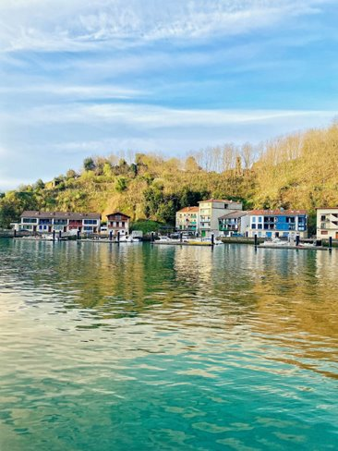
Sustainability Planning
POP. PHASE 2: IDEATE & CO-DESIGN
Launching
Part 1: Recap
Brief recap of the vision-mission and strategic goals; results of the analyses of the strengths, weaknesses, opportunities, and threats; and key stakeholders of the CCLL
Part 2: Developing strategies for the CCLL
Developing strategies for the CCLL to ensure its long-term operational sustainability. You can use the strategy development table below to assist with this.
Strategy: what? | Mission and Strategic Goal(s) targeted | Stakeholder impacted: Who? | Strengths, weaknesses, opportunities, and threats targeted | Value provided: Why? | Competitive advantage | Products and services | Key performance indicators

Slide 29
Sustainability Planning
POP. PHASE 2: IDEATE & CO-DESIGN
Launching
Part 3: Identifying the value provided
Identifying the value provided by the strategy to the stakeholders. You can utilise the Stakeholder Value Importance Matrix below to assist with this process.
Value for the CCLL
High for CCLL
Low for stakeholder(s)
High for CCLL
High for stakeholder(s)
Low for stakeholder(s)
Low for CCLL
High for stakeholder(s)
Low for CCLL
Value for stakeholder(s)

Slide 30
POP. PHASE 3: PROTOTYPE & PILOT
Monitoring
Monitoring is an implementation activity where technology is prototyped and tested to monitor the locations for the designed solutions in the previous activities.
Reviewing and Adapting Vision, Mission, and Strategic Goals
Objective:
Assess whether the Living Lab’s (LL) vision, mission, and strategic goals remain relevant and aligned with the current context. Identify necessary adjustments to enhance impact and effectiveness.
Exercise Structure:
Initial Reflection – Where Are We Now?
Review the current vision, mission, and strategic goals.
Analyse the current context: changes in the environment, emerging needs, opportunities, and challenges.
Identify achievements and barriers in implementing the strategy.
Evaluation of Coherence and Relevance
Vision: Does it still reflect the LL’s long-term aspiration? Is it clear and inspiring?
Mission: Does it accurately represent the LL’s purpose and role today?
Strategic Goals: Are they still aligned with the mission? Are they well-defined and measurable?
Reformulation and Prioritisation
Propose adjustments to the vision and mission if necessary.
Redefine or adjust strategic goals according to current needs.
Establish new priorities and next steps.
Validation and Commitment
Group discussion to validate changes.
Define responsibilities and actions to implement the updated plan.
Ensure commitment from participants to execute the revised direction.
Tools:
This exercise can be conducted using participatory methods such as the Delphi Method, Relevance-Impact Matrix, Stakeholder Mapping, or co-creation dynamics.
​
​

Slide 31
POP. PHASE 3: PROTOTYPE & PILOT
Monitoring
Spotlight of the month- Thematic forums
Objective: Create an online/presential space for CCLLs to share experiences, successes, and challenges in implementing strategies and actions.
Format:
Open forum: When all CCLLs have a similar level of progress, allowing for a shared and horizontal discussion.
Frontrunner guided-forum: When different CCLLs are at varying stages of progress and implementation. In this case, frontrunners will showcase key aspects of their process so that fellows can learn, ask questions, anticipate challenges, and integrate lessons learned into their own processes.
Structure:
Initial presentation
Success cases and challenges
Peer learning and discussion
Closing and conclusions
Tools:
Video Conferencing & Webinars
Collaboration & Engagement Tools: MiroBoard, Mentimeter, Slido
Documentation & Knowledge Sharing: Teams channels
Sample Agenda:
​
​
Spotlight of the month
WELCOME | Presentation of the meeting
WP3 work and outputs explanation | Summary of the main outputs for the 10 CCLLs and its usability
WP6 work and outputs explanation | Summary of the main outputs for the 10 CCLLs and its usability
Frontrunners experience-discussion | Frontrunners' experience and expectations of use of results
Q/A | Questions and discussion of all CCLLs

Slide 32
POP. PHASE 4: TEST & EVALUATE
Learning lessons
Final testing to assess the suitability of the designed solutions and their locations and gathers the main conclusions. The activity aims to identify useful outcomes, barriers, and stakeholder feedback, so they can be considered in future implementation or in other LLs.
Surveys and forms
Survey and feedback forms are tools that can help to gather input from stakeholders and users about their experiences and satisfaction with developed solutions. Analysing the results reviewed for those tools can help to better understand stakeholders’ and users’ needs and enhance their engagement strategies for better outcomes.
I like, I wish, What if
I like, I wish, What if is a tool for collecting, in a structured way, feedback from users. With this tool, the users are invited to provide open feedback by formulating three types of statements: "I like...", "I wish...", and "What if...".
Project | Aspect ! |  |  | Aspect 2 |  |  | Aspect 3 |  |  | Notes
 | Score 0-5 | What is done well | What should be improved (and how) | Score 0-5 | What is done well | What should be improved (and how) | Score 0-5 | What is done well | What should be improved (and how)
Project A
Project B
Lessons learned individual sessions
Facilitate individual reflection on key insights, successes, and challenges experienced in the Living Lab (LL) processes, enabling continuous improvement and knowledge sharing.

Slide 33
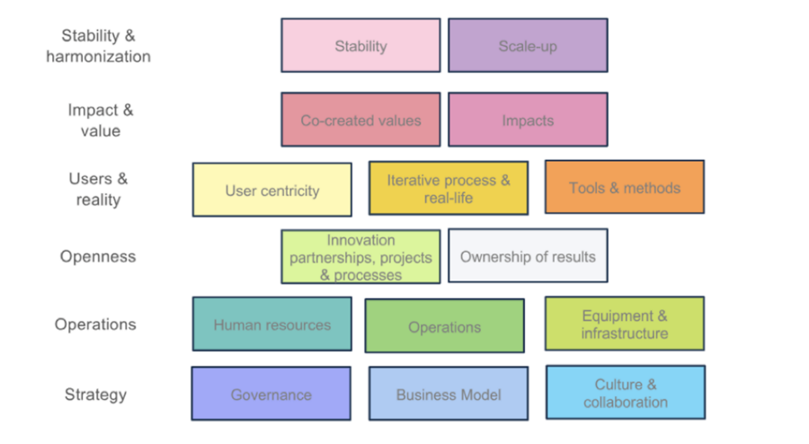
POP. PHASE 4: TEST & EVALUATE
Learning lessons
Sustainability workshops
Objective: Organise a workshop consisting of multiple sessions, each focusing on key aspects of sustainability within Living Labs (LLs). Each session will employ a different format, beginning with an introductory segment led by an expert to provide context and insights. This will be followed by interactive activities using various facilitation tools to foster dialogue, exchange perspectives, and share experiences among Living Labs, enhancing collective learning and collaboration on sustainable approaches.
Workshop Structure:
Each session should follow a clear and engaging structure, ensuring that participants gain both theoretical knowledge and practical insights.
Introduction & Context Setting (Plenary):
Expert presentation to provide an overview of the specific sustainability aspect being addressed.
Case studies or best practices from existing LLs.: Fireside Chat
Interactive Session Formats (Breakout)
Panel Discussion or Roundtable: Experts and LL representatives discuss key challenges and opportunities.
World Café: Rotating small group discussions on subtopics, ensuring diverse perspectives are shared.
Discussion in Pairs/Triads of CCLLs (knowledge exchange and sharing)
Scenario Planning: Teams envision future sustainability pathways for LLs.
Mapping Exercise: Collaborative work on identifying synergies and gaps in sustainability approaches.
Synthesis & Takeaways (Plenary)
Summary of key insights.
Identification of common challenges and possible solutions.
Open floor for final thoughts and next steps.

